Slide 1

TURTLEBOT
Wall
and
Line following

Slide 2

Our Team
Mariia Murina
Qadeem Khan
Malik Danial Ahmed
Anna Parshukova
Arham Sajjad

Slide 3
Introduction
This presentation details the development of a ROS (Robot Operating System) node designed for a TurtleBot robot to execute wall-following and line-following tasks. The node leverages sensor data from LiDAR and a camera for real-time navigation and incorporates a PID controller to ensure accurate adjustments during line-following.

Slide 4
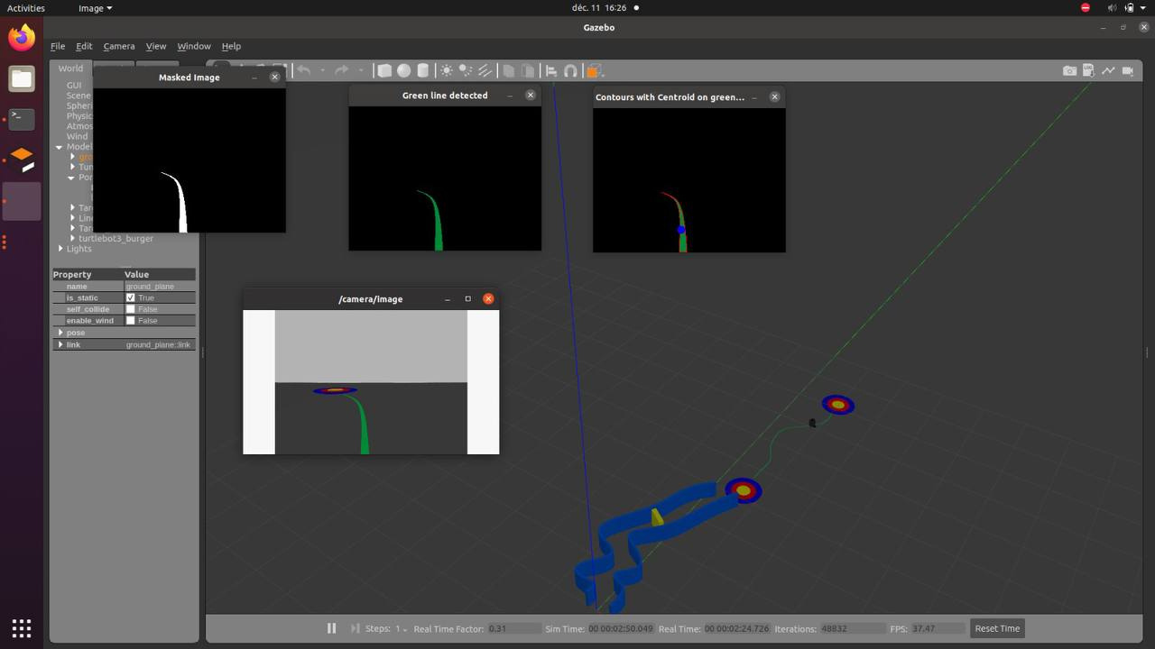
General View

Slide 5
ROS
The Robot Operating System (ROS) is a set of software libraries and tools that help you build robot applications. From drivers to state-of-the-art algorithms, and with powerful developer tools. ROS is great for robotics projects and it's all open source.

Slide 6
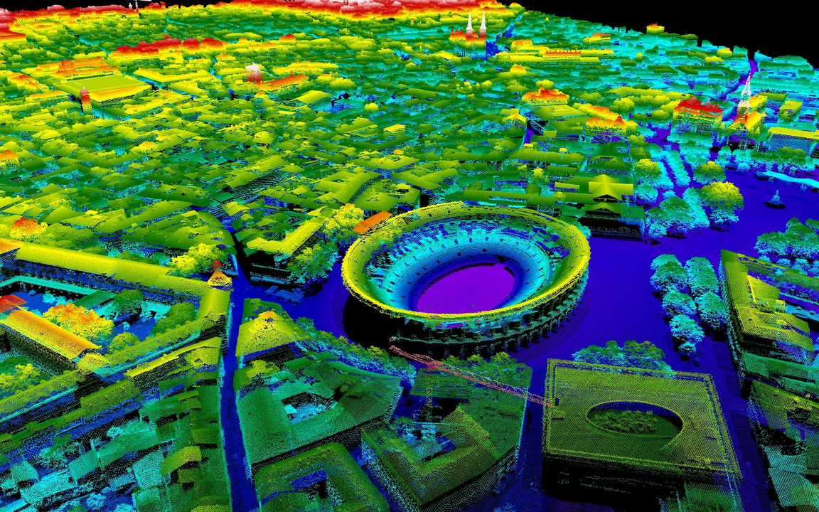
LiDAR
LiDAR or Light Detection and Ranging is an active remote sensing system that can be used to measure vegetation height across wide areas.

Slide 7
About Our Project
Goal: Enable a Turtlebot to follow walls and lines using LIDAR and a camera.
Overview: Utilize sensor data and PID control to adjust the robot's movement in real-time for autonomous navigation.

Slide 8
Key Libraries and Packages
ROS (rospy): Core library for managing ROS nodes and communication.
sensor_msgs.msg: Imports message types for LIDAR and camera data.
﻿﻿geometry_msgs.msg: Twist messages for robot movement.
﻿﻿cv_bridge: Converts ROS image messages to OpenCV images.
﻿﻿OpenCV (cv2): Image processing library.
﻿﻿NumPy: Efficient handling of arrays and calculations.

Slide 9
Code Structure
The code consists of the following main components:
1. Wall Following (LiDAR): - Processes data from the '/scan' topic to detect walls and obstacles. - Implements logic to adjust linear and angular velocities to navigate corridors safely.
2. Line Following (Camera): - Subscribes to the '/camera/image' topic to receive image data. - Uses OpenCV to detect a line in the image and computes its centroid.
3. PID Controller: - Calculates proportional, integral, and derivative corrections to ensure smooth line tracking.
4. ROS Integration: - Publishes movement commands to the '/cmd_vel' topic to control the robot's motion

Slide 10
ROS Components
The project is built using ROS (Robot Operating System).
Launching File Elements (from the PDF)​(launch_file_code_with_e…):
Gazebo World Setup:
The custom world file (wall_line.world) is loaded into Gazebo.
Parameters like simulation time (use_sim_time) and GUI mode (gui) are set.
Robot Spawning:
The TurtleBot3 model is spawned at a specific location in the Gazebo world using its URDF description file (Universal Robot Description Format).
The robot’s position (x=0.0, y=0.0, z=0.0) and orientation (Y=1.557) are specified.

Slide 11
ROS Components
Wall Obstacle Simulation:
The world_control.py script simulates dynamic obstacles (e.g., moving walls and doors).
Wall and Line Following:
The wall_line_following.py script contains the logic for both wall-following and line-following behaviors.
Camera Feed:
The image_view node displays the robot’s camera feed in real time.

Slide 12
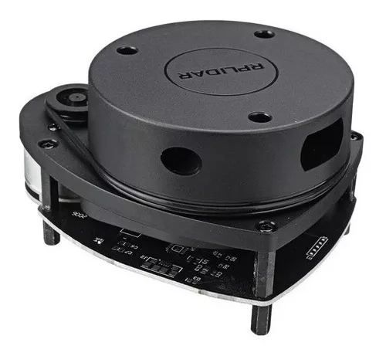
Algorithms and Logic
Wall Following Logic
The wall following logic uses LiDAR data to measure distances in specific directions.
What is LiDAR:
Lidar — Light Detection and Ranging is a remote sensing
method used to examine the surface of the Earth.

Slide 13
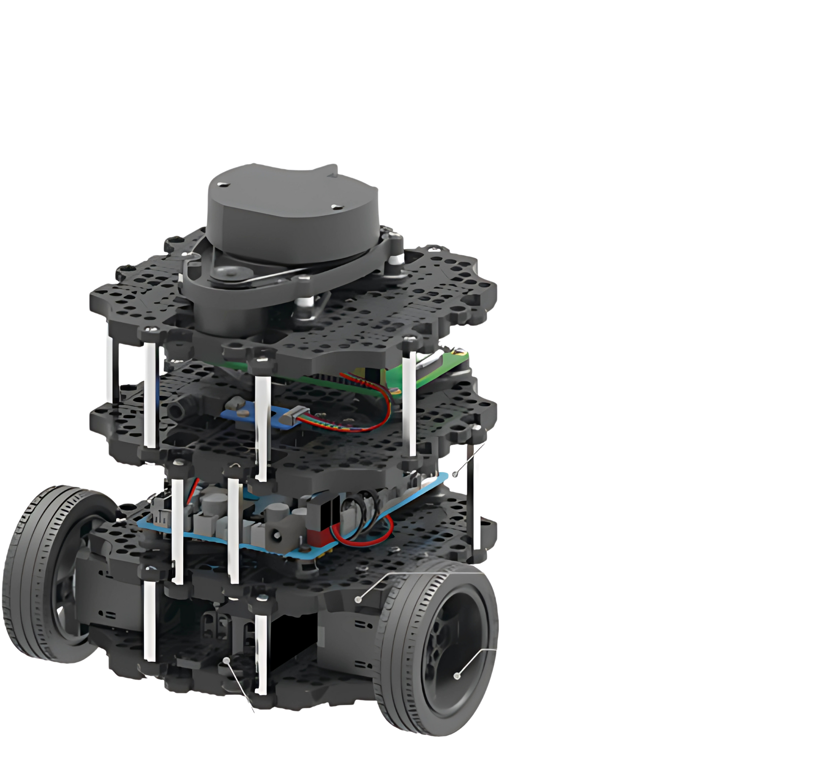


360 LiDAR

Slide 14
LiDAR Wall Following Angles
Front (355° to 360°): Detects obstacles directly ahead.
Front-Left (0° to 70°): Measures proximity to the left wall.
Front-Right (270° to 340°): Measures proximity to the right wall.
Side Distances: Helps detect the end of walls

Slide 15
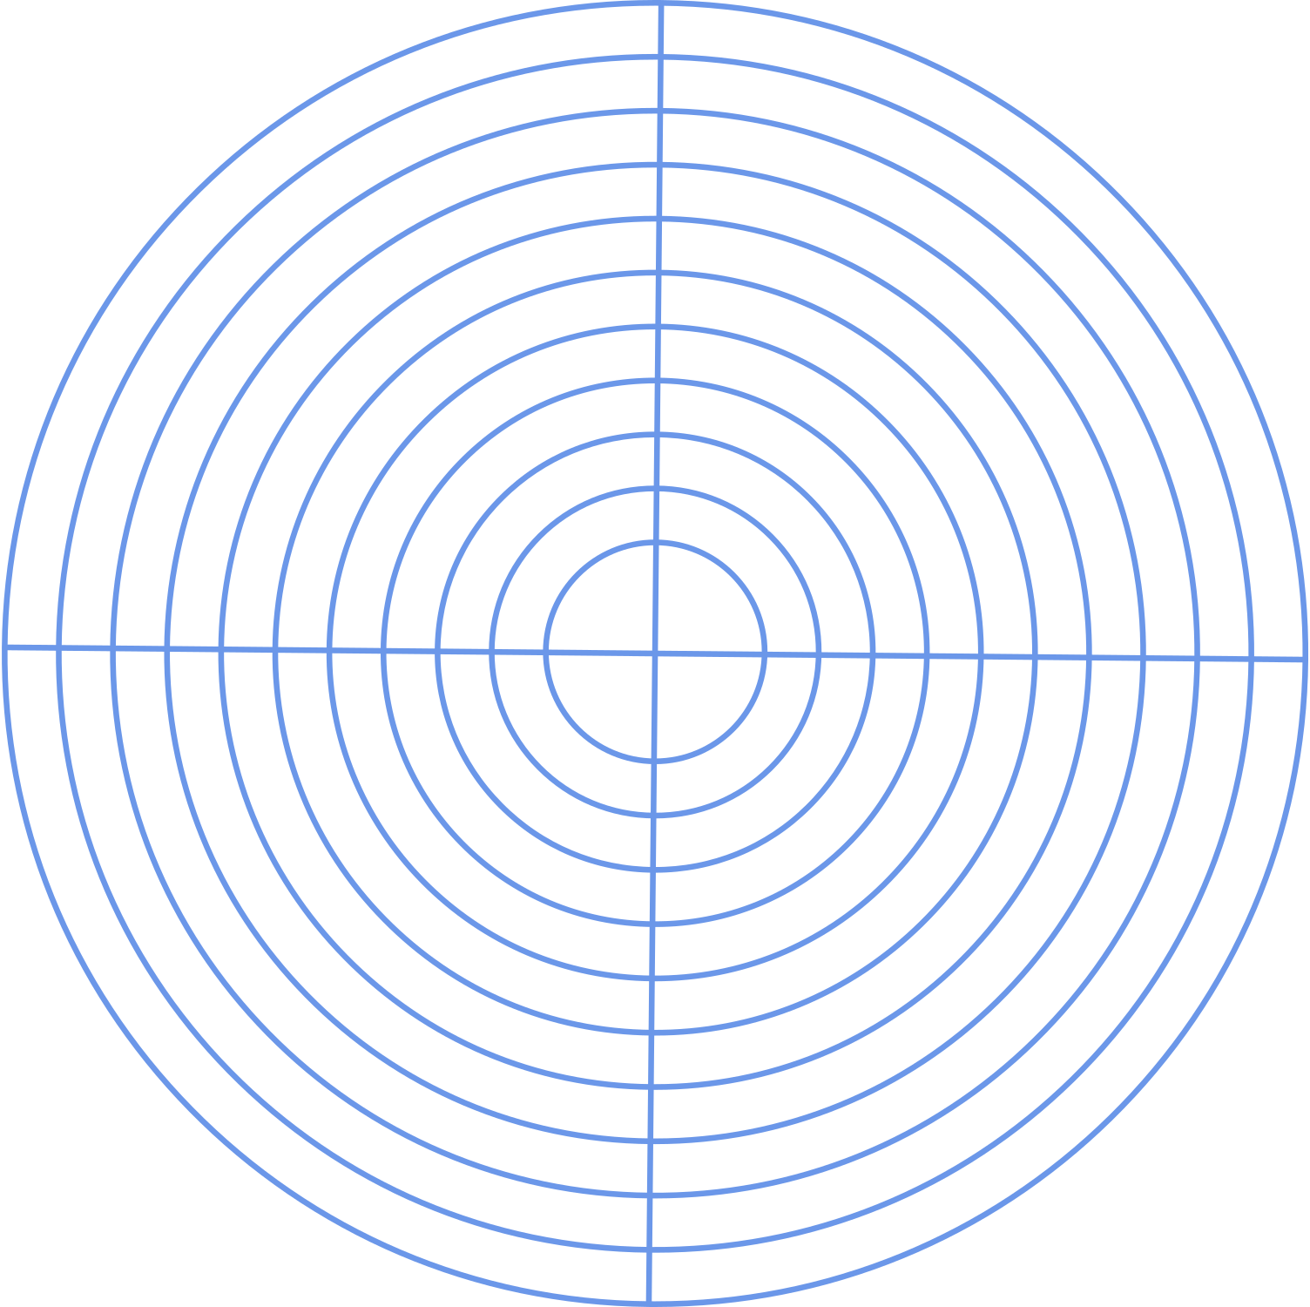
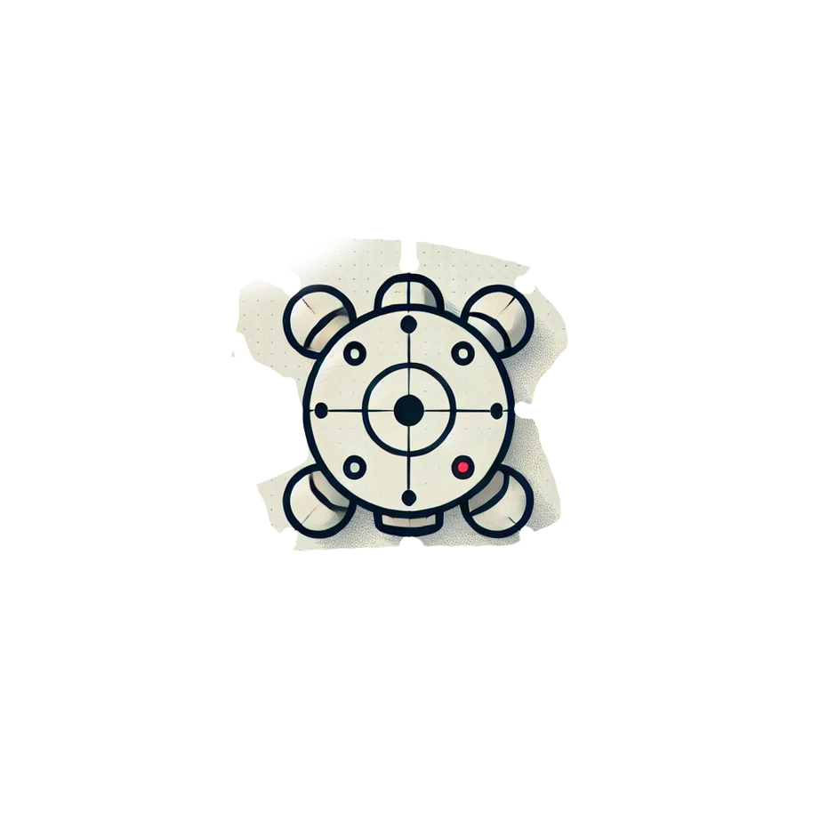
0° / 360°
355°
FRONT
340°
LEFT
70°
RIGHT
270°
BACK

Slide 16
Decisions are made based on these distances:
01
02
03
Stop if an obstacle is detected in the front.
Turn away from walls that are too close.
Move forward when the path is clear.
Minimum distance range is 0.03 meter for left and right side
Minimum distance range 0.15 meter
Linear Velocity is 0.5 meter per sec
Angular velocity towards right side is +0.65 meter per sec & -0.65 for left side

Slide 17
Line Following Logic:
The line following logic uses camera data processed with OpenCV: Converts the RGB image to HSV and masks a specific color (e.g., green).
Detects contours in the masked image and identifies the largest one.
Computes the centroid of the contour and calculates the error relative to the camera center.
Uses a PID controller to adjust angular velocity based on the error
Velocity limitation is 0.65 to -0.65 meter per sec

Slide 18
PID Controller
The PID controller ensures smooth and precise line tracking. Its components are:
Proportional (P): Corrects based on the current error.
Integral (I): Compensates for accumulated past errors.
Derivative (D): Predicts future errors based on the rate of chan.
The control signal is computed as:
PID = Kp * error + Ki * integral + Kd * derivative
Where Kp, Ki, and Kd are the controller gains

Slide 19
Visualizations
During execution, the node provides visual outputs for debugging:
Masked image showing the detected line
Contours drawn around the detected line
Centroid of the line highlighted for error calculation

Slide 20
Execution Steps
1. Run the ROS node
2. Launch the robot simulation or hardware
3. Verify Camera Topics
4. Monitor Navigation
5. Adjust PID Gains
6. Iterative Improvement

Slide 21
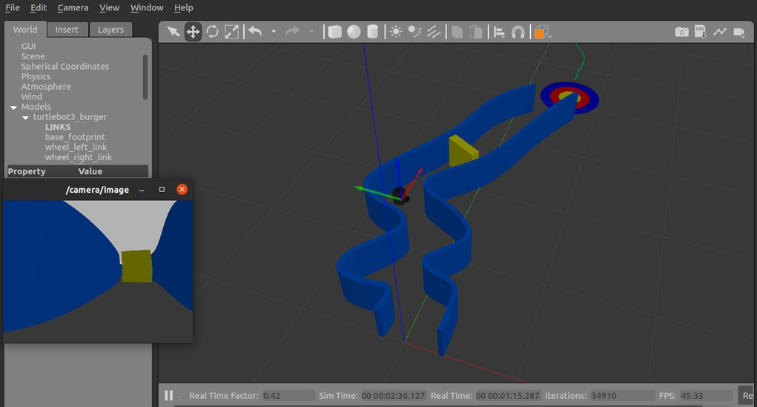
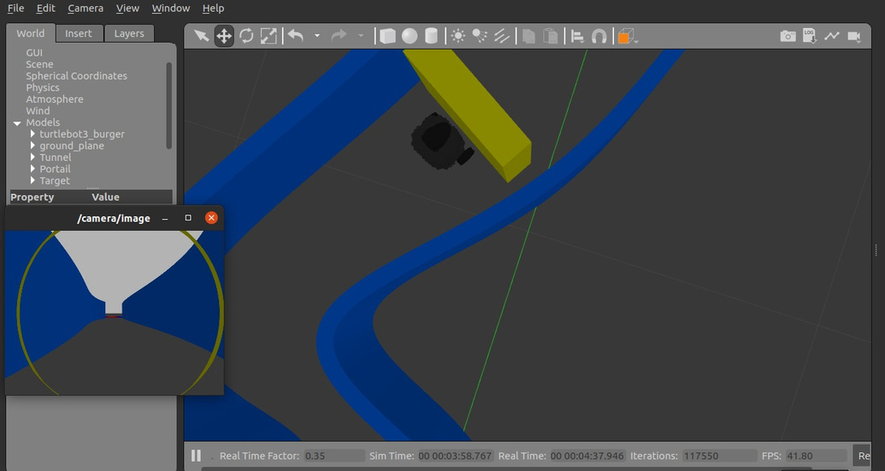
Real Time Camera Feed
Obstacle Detection

Slide 22
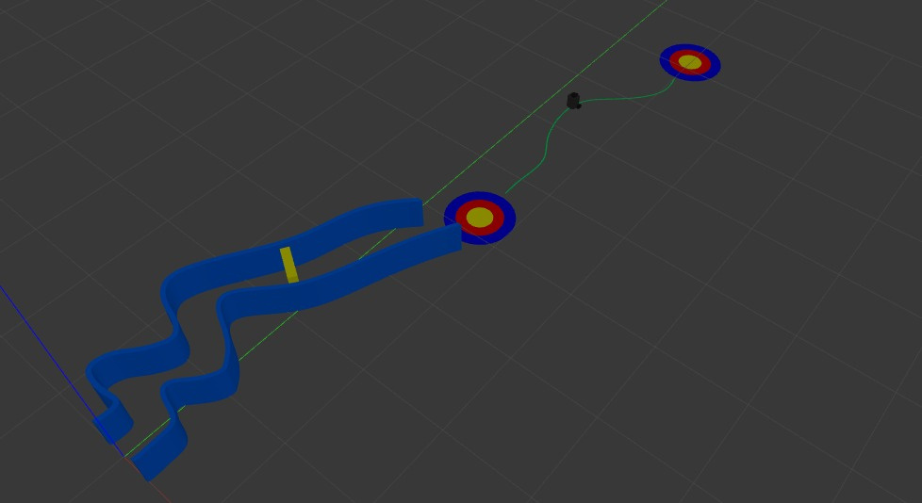
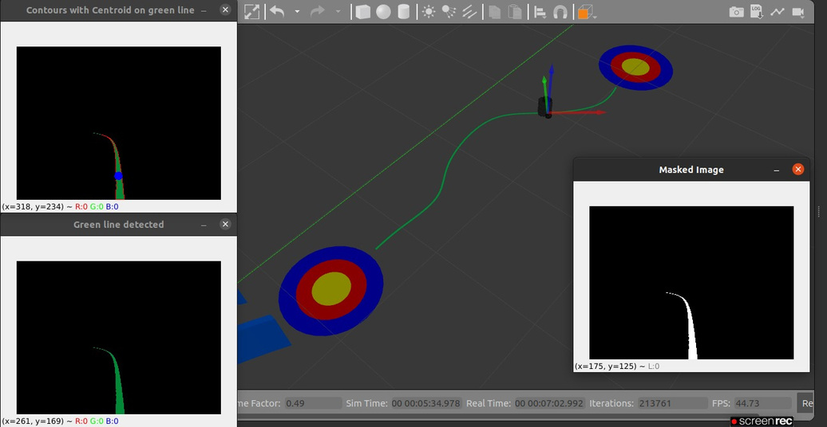
Line following logic
Line Following With Real Time Camera Feed

Slide 23
Advantages and Limitations
Advantages:
Real-time navigation using sensor data.
Combines wall following and line following capabilities.
PID controller ensures smooth and precise motion.
Limitations:
Limited to environments with clear walls and lines.
Performance depends on sensor calibration and lighting conditions.
May require parameter tuning for optimal PID performance

Slide 24
Summary and Applications
Summary: Turtlebot combines LIDAR and camera data for wall and line following, with PID control for smooth navigation
﻿﻿Applications: Autonomous navigation in constrained environments, obstacle avoidance, industrial automation.

Slide 25
Thank You!

